Slide 1
Chinese Postman Problem
In his job, a postman picks up mail at the post office, delivers it, and then returns to the post office. He must, of course, cover each street in his area at least once. Subject to this condition, he wishes to choose his route in such a way that walks as little as possible. This problem is known as the Chinese postman problem, since it was first considered by a Chinese mathematician, Guan in 1960.
Graphic Model
We refer to the street system as a weighted graph (G,w) whose vertices represent the intersections of the streets, whose edges represent the streets (one-way or two way), and the weight represents the distance between two intersections, of course, a positive real number. A closed walk that covers each edge at least once in G is called a postman tour. Clearly, the Chinese postman problem is just that of finding a minimum-weight postman tour. We will refer to such a postman tour as an optimal tour.

Slide 2
Chinese Postman Problem
To find a minimum Chinese postman route we must walk
along each edge at least once and in addition we must also
walk along the least pairings of odd vertices on one extra
occasion.
An algorithm for finding an optimal Chinese postman
route is:
Step 1 List all odd vertices.
Step 2 List all possible pairings of odd vertices.
Step 3 For each pairing find the edges that connect the vertices with the minimum weight.
Step 4 Find the pairings such that the sum of the weights is minimized.
Step 5 On the original graph add the edges that have been found in Step 4.
Step 6 The length of an optimal Chinese postman route is the sum of all the edges added to the total found in Step 4.
Step 7 A route corresponding to this minimum weight can then be easily found.

Slide 3
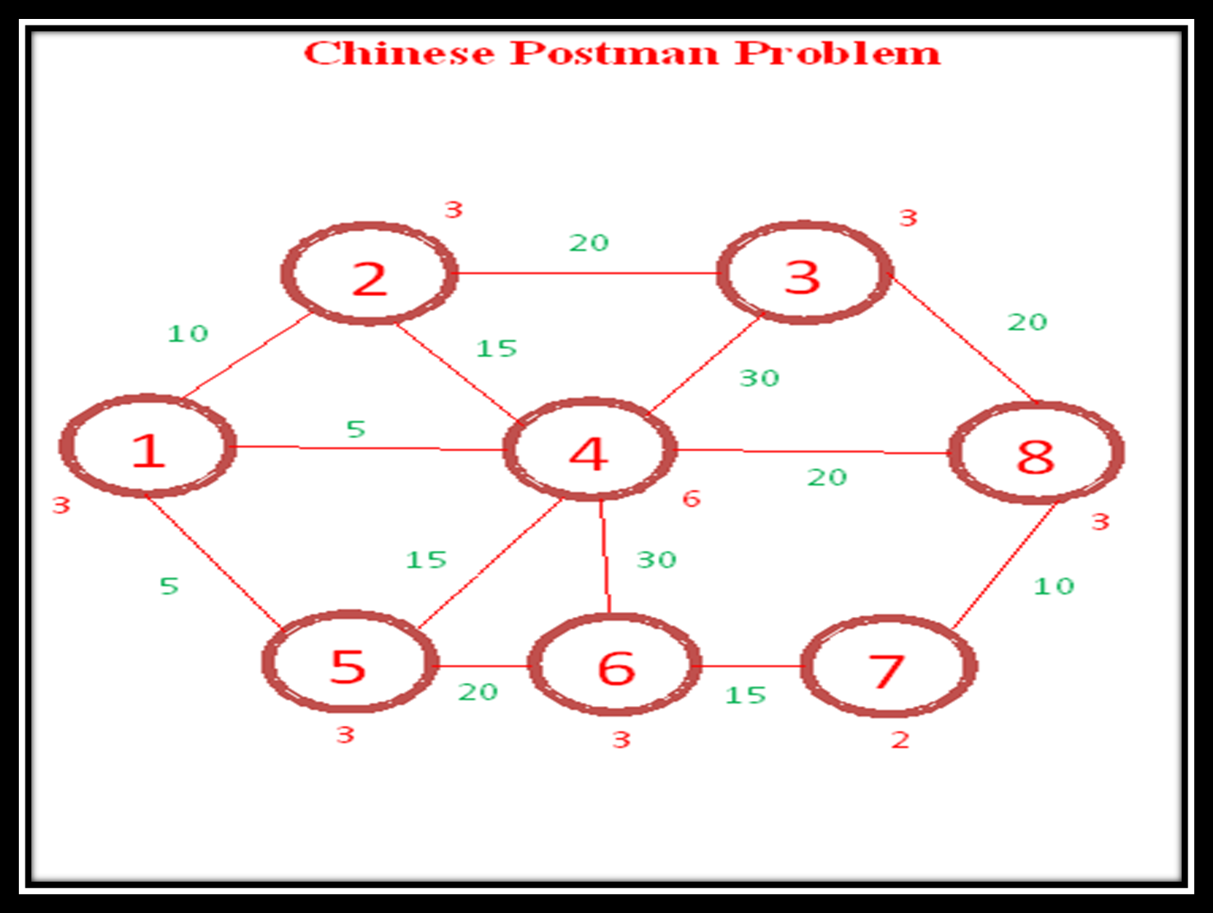
Graph is not Eulerian

Slide 4
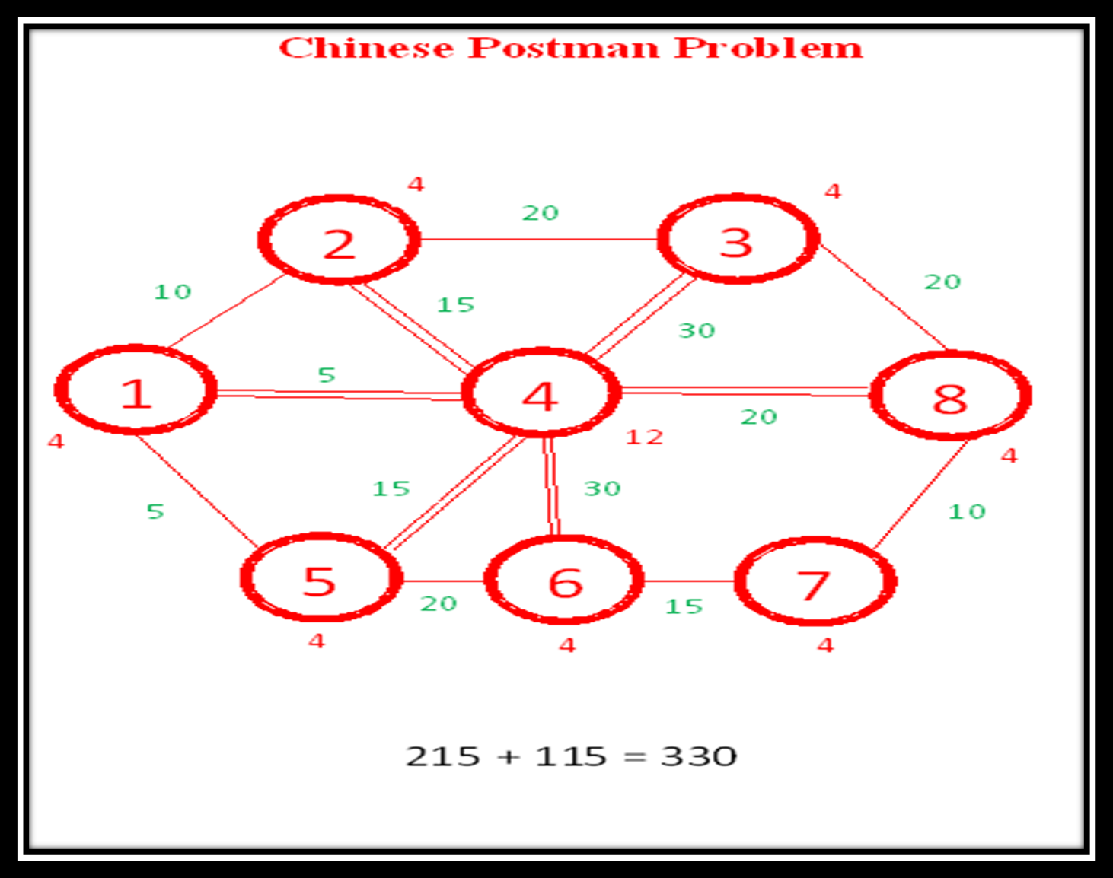
Graph is Eulerian

Slide 5
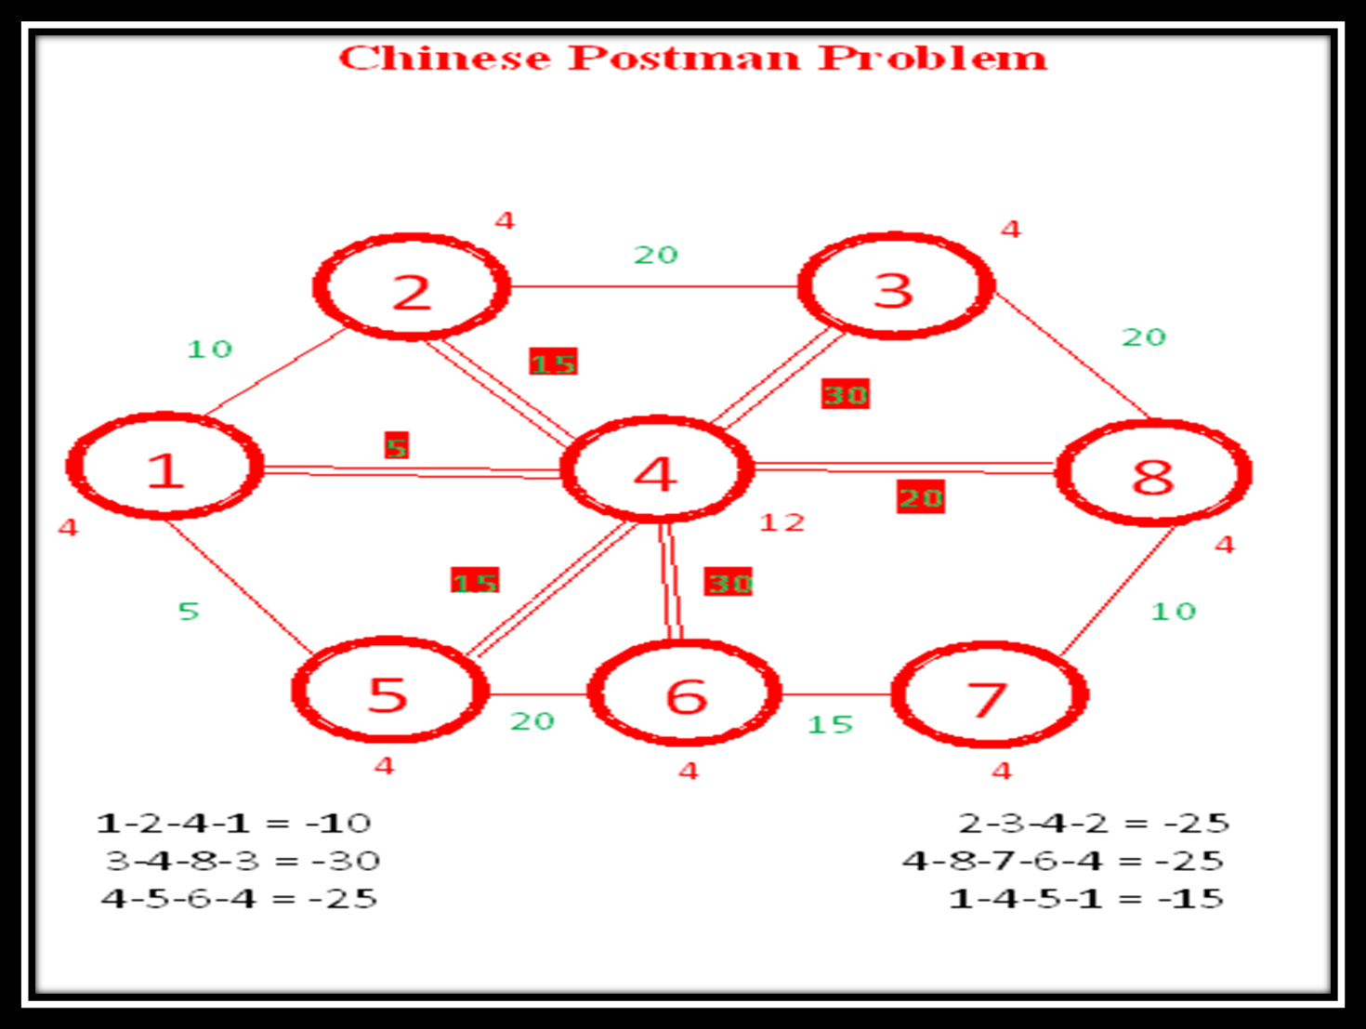
-
Negative Cycles

Slide 6
We can take the most negative cycle, which is the one with minus 30 and then perform some operations. So what we do now, take the negative cycle 3-4, 4-8, 8-3 and simply change the duplications.
What we are going to do now is 3-4, 4-8, 8-3 here there is duplications, so bring it back remove the duplication. Now go back and see whether we can get one more negative cycle out of this.
We said 4-5, 5-6, 6-4 is a negative cycle 4-5, 5-6, 6-4 minus 45 plus 20.So let us consider this to begin with minus 45 plus 20 so we get a saving of 25 out of this. So wherever there is duplication, change it so, this minus 15 is going to become a plus 15. This minus 30 goes this will become a plus 30, but this 20 will now be duplicated and we will get a minus 20 here and we have made a saving of another 25.
So wherever there is duplication, change it so till all negative cycle completed.

Slide 7
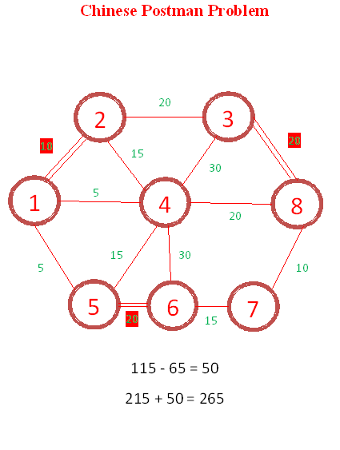
Remove Duplication Start From Most Negative Cycles

Slide 8
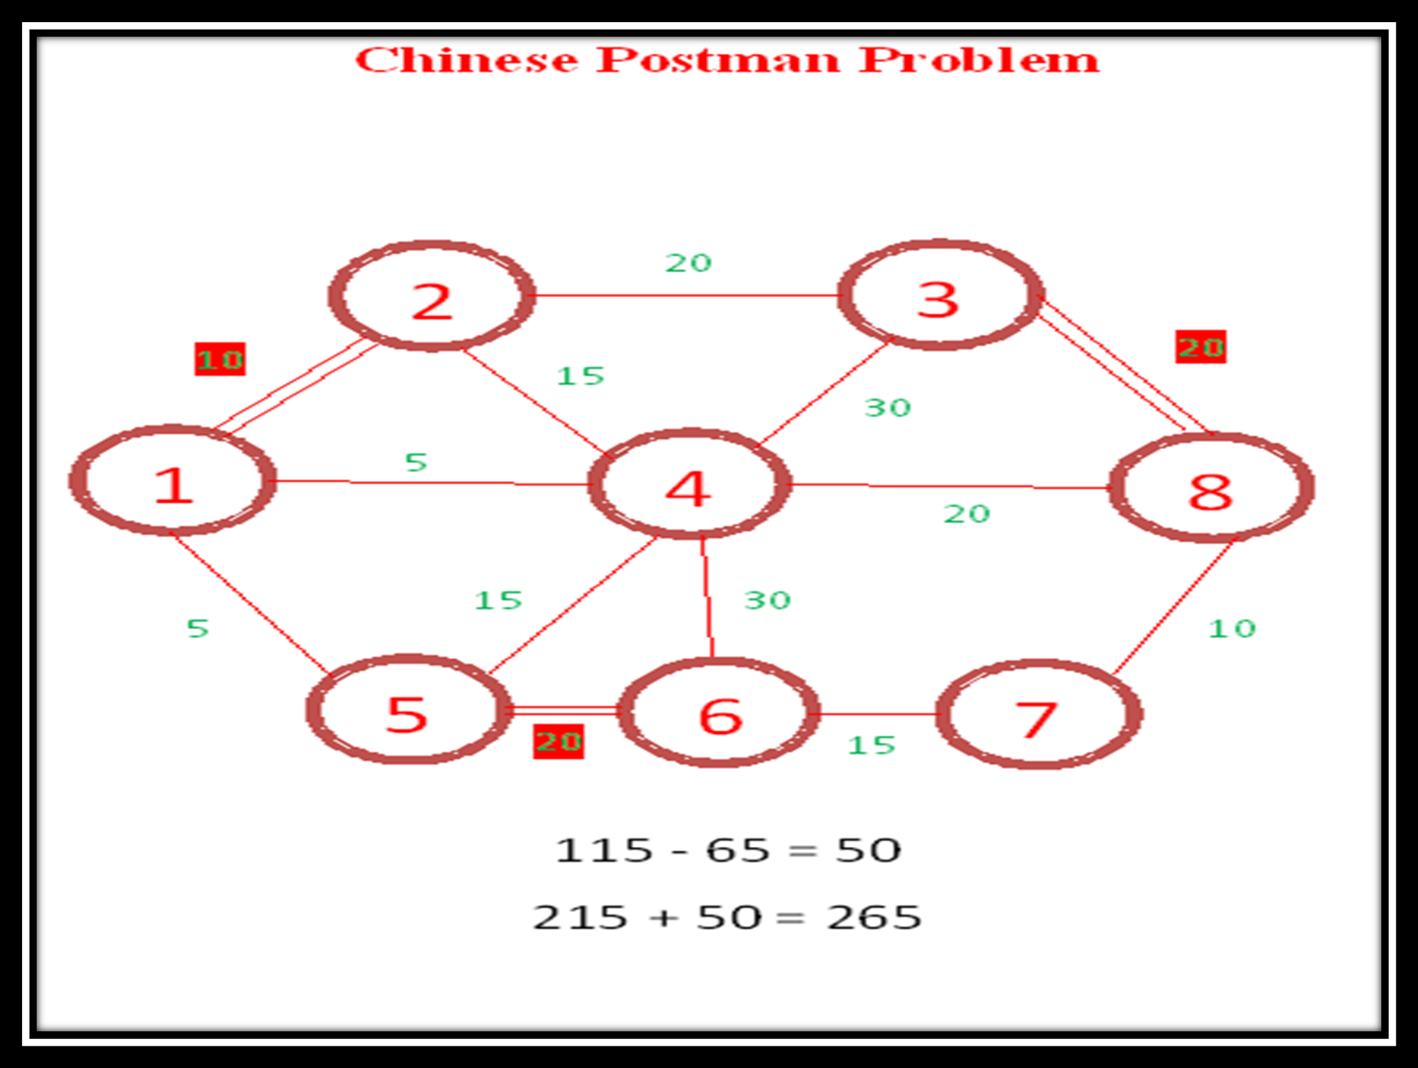

Slide 9
Construct Matrix of shortest Distance Using Dijkstra’s Algorithm
Graph is not Eulerian

Slide 10
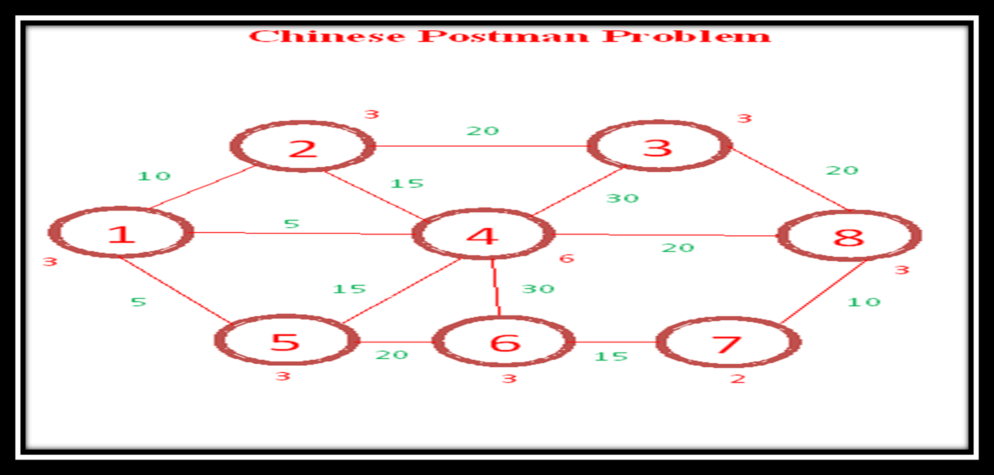

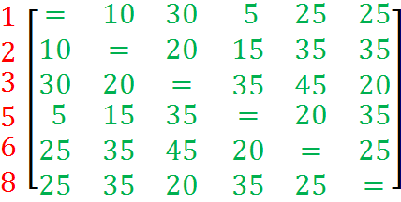
Construct Matrix of shortest Distance Using Dijkstra’s Algorithm Of Odd Vertices

Slide 11
If there are six odd vertices ABCDEF, then consider the vertex A.It can be paired with any of the other five vertices and still leave four odd vertices. We know that the four odd vertices can be paired in three ways; therefore the number of ways of pairing six odd vertices is 5x3x1=15.
Pairs Of 6 Odd Vertices =15 Ways
12 | 13 | 15 | 16 | 18
 | 23 | 25 | 26 | 28
 |  | 35 | 36 | 38
 |  |  | 56 | 58
 |  |  |  | 68

Slide 12
Pairs Of Vertices ( Taken Three At A Time )
12 | 35 | 68 | = | 70 |  | 16 | 23 | 58 | = | 80
12 | 36 | 58 | = | 90 |  | 16 | 25 | 38 | = | 60
12 | 38 | 56 | = | 50 |  | 16 | 28 | 35 | = | 95
13 | 25 | 68 | = | 70 |  | 18 | 23 | 56 | = | 65
13 | 26 | 58 | = | 100 |  | 18 | 25 | 36 | = | 85
13 | 28 | 56 | = | 85 |  | 18 | 26 | 35 | = | 95
15 | 23 | 68 | = | 50
15 | 26 | 38 | = | 60
15 | 28 | 36 | = | 85

Slide 13



Slide 14
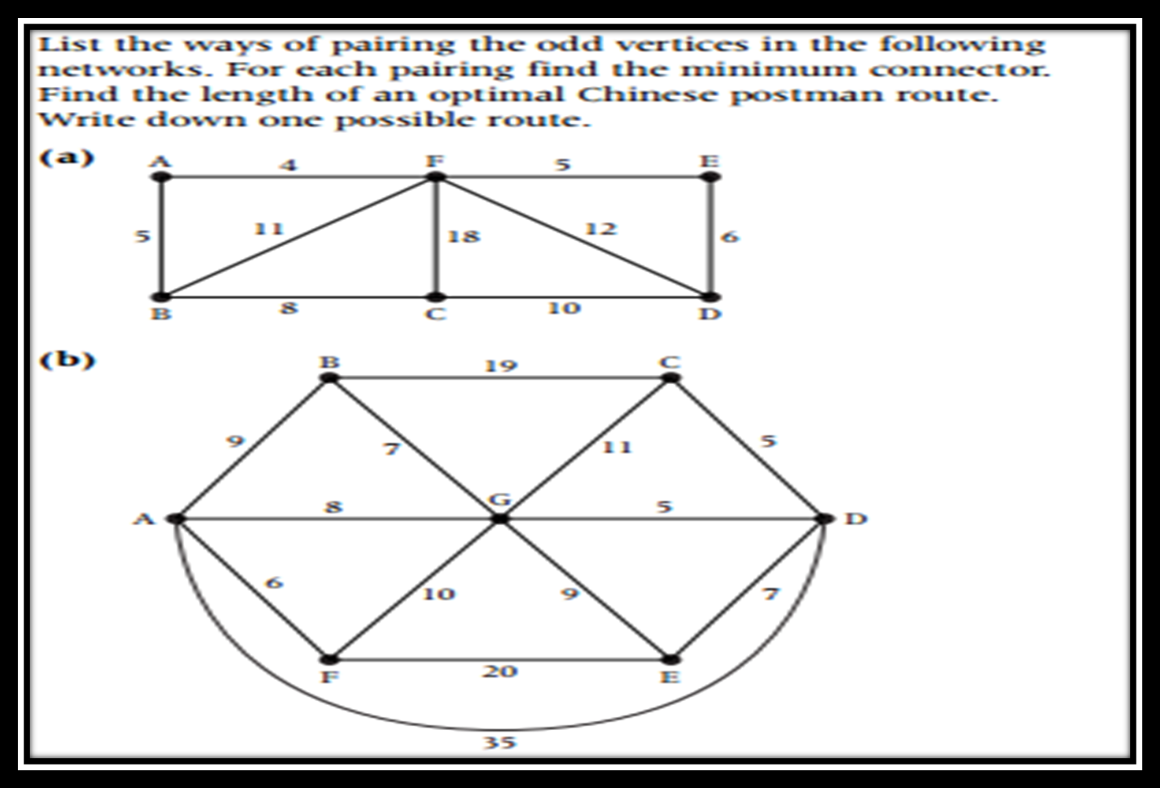
Class Work

Slide 15
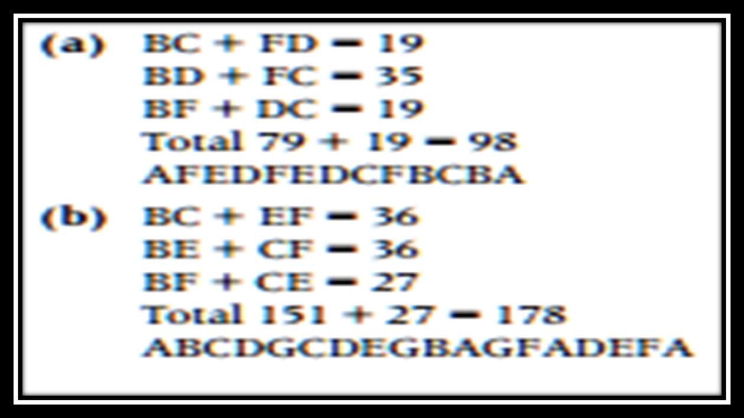

Slide 16
Application of Chinese Postman Problem
The practical example is planning of bus routing. In order to save the cost on the fuel, the bus company have modelled the bus stop as the vertix and the road as the edge in the bus route, then using the graph theory to obtain the optimal route that can meet the target of using the minimal fuel but across every road, at least once.
Other application includes trash collection, road sweeping, snow-plows, highway lawnmowers, transmission line inspections, school bus routing, etc.

